Slide 1

Youth YANA ( You Are Not Alone ) Mental Health Consulting WebApp
Group Details: GID- 41
Sumit Kawale ( 43323 )
Harshvardhan Patil ( 43346 )
Onkar Swami ( 43374 )
Tanmay Bonde ( 43375 )
Guide Details:
Mrs. Kirti Digholkar
Reviewer 1 Details :
Mr. Sachin Pande
Reviewer 2 Details :
Mrs.Prajakta Shinde

Slide 2
Agenda
Introduction
Motivation
Problem definition
Gap finding
Purpose & Scope
Objective
Literature Survey
Block
Diagram
Presentation Title

Slide 3

Introduction
Mental Health Problem is Faced by College Students
Limited resources and long waiting time for counseling.
Unformattable to share the problem with others.
To address these issues, we propose the implementation of an AI-driven mental health consulting system that maintains the confidentiality of student data while providing effective and accessible support.

Slide 4


Growing mental health crisis among college students. The pressures of academic life, personal relationships, and societal expectations can take a toll on students' mental well-being. Traditional counseling services often fall short in meeting. To bridge this gap and offer a more inclusive and confidential solution.
MOTIVATION

Slide 5

Purpose and Scope
Purpose: Purpose of our BE project is to provide Mental assistance to College Students and others and patients for general purpose symptoms and vital Mental disease information using Various model.
Scope: The scope includes collecting relevant datasets, preprocessing the data, evaluating the system's performance. It includes database management, ML techniques, and MERB (MongoDB, Elysia, React.js, Bun.js) integration, with considerations for usability testing and scalability.

Slide 6
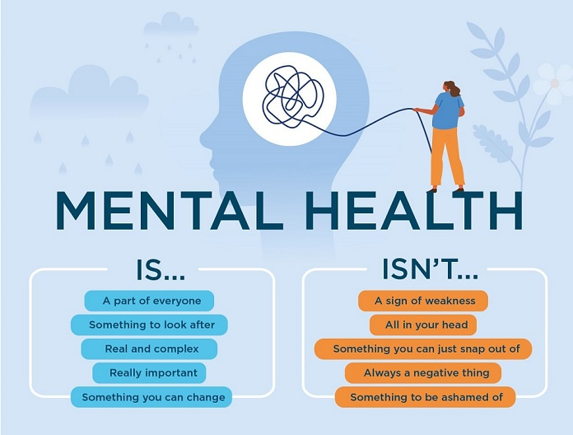
Objectives
Raise Awareness
Destigmatize Mental Health
Identify Common Mental Health Issues
Emphasize Early Intervention
Discuss Self-Help Strategies
Highlight Professional Counseling

Slide 7
Problem Definition
The primary problem we aim to address is the limited accessibility and confidentiality issues surrounding mental health counseling for college students.
Key aspects of the problem include:
Limited Resources: Universities often have a shortage of mental health professionals, leading to long wait times for appointments.
Stigma: There is a stigma surrounding mental health, preventing many students from seeking help.
Confidentiality: Students may be hesitant to share their thoughts and feelings with human counselors due to concerns about privacy and judgment.
Accessibility: Some students may not have access to counseling services due to geographical constraints or other logistical barriers.

Slide 8
Literature Survey
Year | Author | Domain and Problem Statement | Conclusion and result
2021 | V.D.Kulkarni, Tanuja Gondkar, Gunjan Singh, Aditi Gulunjkar | Addressing Mental Health Epidemic among University Students via Web-based, Self-Screening, and Referral System (1) | This system is suitable for university students, staff, and workers experiencing mental health issues due to studies, addiction, or bad habits. It is also applicable in hospitals and industries for confirming normality.
2021 | Eung-Hun Kim, Anil Coumar, William B. Lober, and Yongmin Kim | Addressing Mental Health Epidemic Among University Students via Web-based, Self-Screening, and Referral System: A Preliminary Study (2) | A web-based mental health screening and referral system for university students was developed and evaluated, showing increased patient volume, high off-hour use, and positive student responses. Converted to routine clinical use.

Slide 9
Literature Survey
Year | Author | Domain and Problem Statement | Conclusion and result
2020 | ROHIZAH ABD RAHMAN 1 , KHAIRUDDIN OMAR 1 , SHAHRUL AZMAN MOHD NOAH1 , (Member, IEEE), MOHD SHAHRUL NIZAM MOHD DANURI 2 , (Member, IEEE), AND MOHAMMED ALI AL-GARADI | Application of Machine Learning Methods in Mental Health Detection: A Systematic Review (3) | This systematic review evaluates mental health problem detection using OSNs, focusing on data source, feature extraction, and ML techniques. It suggests OSNs can complement traditional methods but requires further adoption and innovative algorithms.
2021 | Ms. Sumathi M.R. , Dr. B. Poorna | Prediction of Mental Health Problems Among Children Using Machine Learning Techniques (4) | Expert systems in medical and mental health fields predict diseases and mental health problems early. A study comparing eight ML techniques found MLP , Multiclass Classifier, and LAD Tree produce more accurate results.

Slide 10
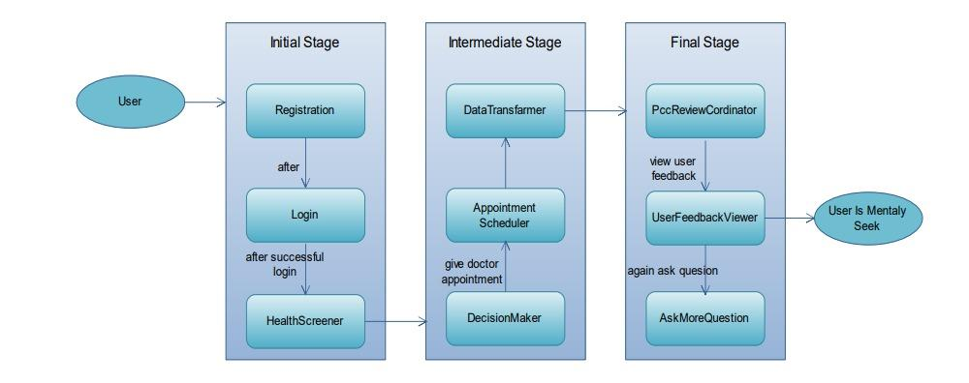
BLOCK DIAGRAM
Ref. – (1)

Slide 11
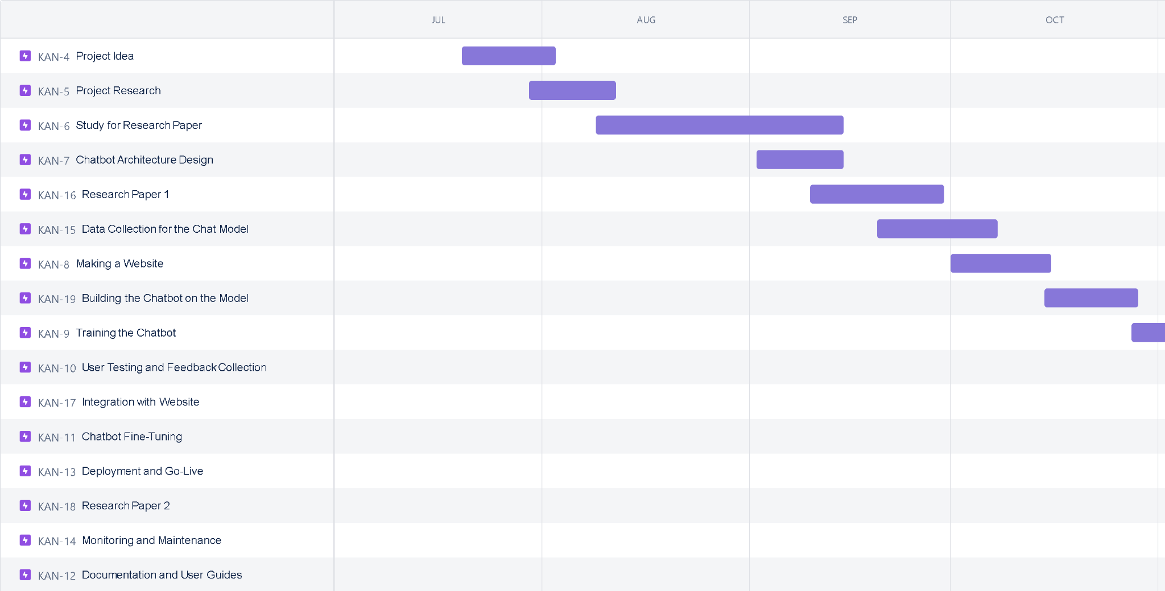
GANTT CHART

Slide 12


Conclusion
In conclusion, our project aims to revolutionize mental health support for college students by leveraging AI technology. By addressing the issues of limited accessibility and confidentiality, we aspire to provide a safe and inclusive platform for students to seek assistance with their mental health concerns. This project has the potential to positively impact the lives of countless students and contribute to a healthier and more resilient college community.

Slide 13
References
Prediction of Mental Health Problems Among Children Using Machine Learning Techniques (thesai.org) (2021)
Application of Machine Learning Methods in Mental Health Detection: A Systematic Review | IEEE Journals & Magazine | IEEE Xplore(2020)
Addressing Mental Health Epidemic Among University Students via Web-based, Self-Screening, and Referral System: A Preliminary Study | IEEE Journals & Magazine | IEEE Xplore (2021)
https://www.researchgate.net/publication/292944128_Prediction_of_Mental_Health_Problems_Among_Children_Using_Machine_Learning_Techniques (2021)

Slide 14




Thank you

